Slide 1
Evaluating Information
Genome 575: Fundamentals of Biomedical Instrumentation
Brian Beliveau

Slide 2
Recap from last time
Information can be discrete or continuous
Sampling rate is a very important consideration
Information can be quantized (bits)
Information entropy describes the “expected surprisal”

Slide 3
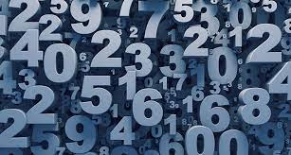
The guessing games
H(X=1–100) = - sum(1-100)[1/100 * log₂(1/100)] = 6.64 bits
I(X=50, match) = -log(1/100) = 6.64 bits
I(X=50, lower) = - log₂(49/100) = 1.03 bits
I(X=50, higher) = - log₂(50/100) = 1 bit
I(X=33, match) = -log(1/100) = 6.64 bits
I(X=33, lower) = - log2(32/100) = 1.64 bits
I(X=33, higher) = - log2(67/100) = 0.58 bits
https://www.sciencenews.org/wp-content/uploads/2018/05/050718_EC_numbers_feat.jpg

Slide 4
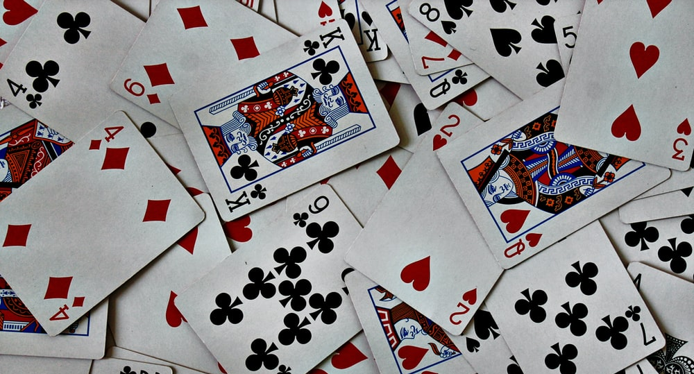
The guessing games
H(X=card) = - sum(1-52)[1/52 * log₂(1/52)] = 5.70 bits
I(X=color, match) = -log₂ (1/2) = 1 bit
I(X= color, miss) = -log₂(1/2) = 1 bit
I(X=suit, match) = -log₂(1/4) = 2 bits
I(X=suit, miss) = -log₂(3/4) = 0.42 bits
I(X=7, match) = -log₂ (1/13) = 3.7 bits
I(X=value, lower) = -log₂ (6/13) = 1.12 bits
I(X=value, higher) = -log₂ (6/13) = 1.12 bits
I(X=Jack, match) = -log₂ (1/13) = 3.7 bits
I(X=Jack, lower) = -log₂ (10/13) = 0.38 bits
I(X=Jack, higher) = -log₂ (2/13) = 2.7 bits
I(X=Y of Z, ie, exact identity, success) = -log₂(1/52) = 5.7 bits
I(X=Y of Z, ie, exact identity, failure) = -log₂(51/52) = 0.03 bits
https://images.unsplash.com/photo-1541278107931-e006523892df?ixlib=rb-1.2.1&ixid=MnwxMjA3fDB8MHxzZWFyY2h8MXx8Y2FyZHN8ZW58MHx8MHx8&w=1000&q=80

Slide 5
How do we evaluate information?
Class activity (10 mins): What questions should we ask about data/datasets?
Supplementary Dataset 1
https://www.tampabay.com/resizer/geVYWof5v2nP75k6cGzYunNkMRc=/1400x2500/smart/arc-anglerfish-arc2-prod-tbt.s3.amazonaws.com/public/KAE7GFWHDQI6TBKNIBWI6S7HAY.jpg

Slide 6

How do we evaluate information?
Supplementary Dataset 1
Sample size?
Statistical testing?
QC metrics?
Methods well described?
Technical replicates?
Biological replicates?
Confounding variables?
Data stratification?
Over-fitting / leakage?
Aliasing / artifacts?
Misconduct?
https://images.emojiterra.com/google/android-11/512px/1f914.png

Slide 7
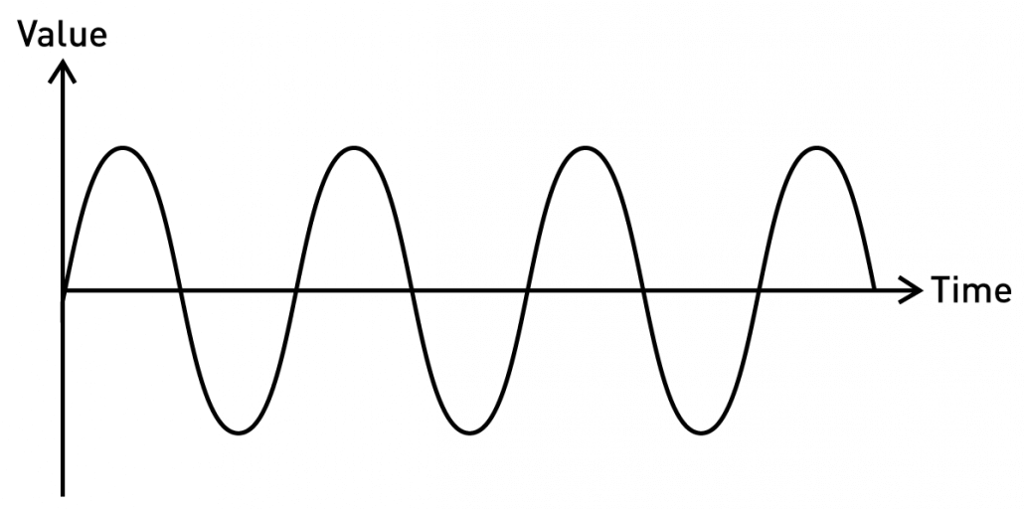
Reminder: types of information
Continuous / Analog
Fully defined. Ie, f(t) == val for any t (in some interval)
Properties such as f, wavelength, amplitude can convey information
https://blog.seeedstudio.com/wp-content/uploads/2020/06/sine-new-1030x512.png

Slide 8
Evaluating continuous information
Goodness of fit / likelihood
RMSE
https://blog.seeedstudio.com/wp-content/uploads/2020/06/sine-new-1030x512.png

Slide 9
Thresholding
Turns continuous information into binary (and discrete)
Establishes decision boundaries
https://blog.seeedstudio.com/wp-content/uploads/2020/06/sine-new-1030x512.png

Slide 10
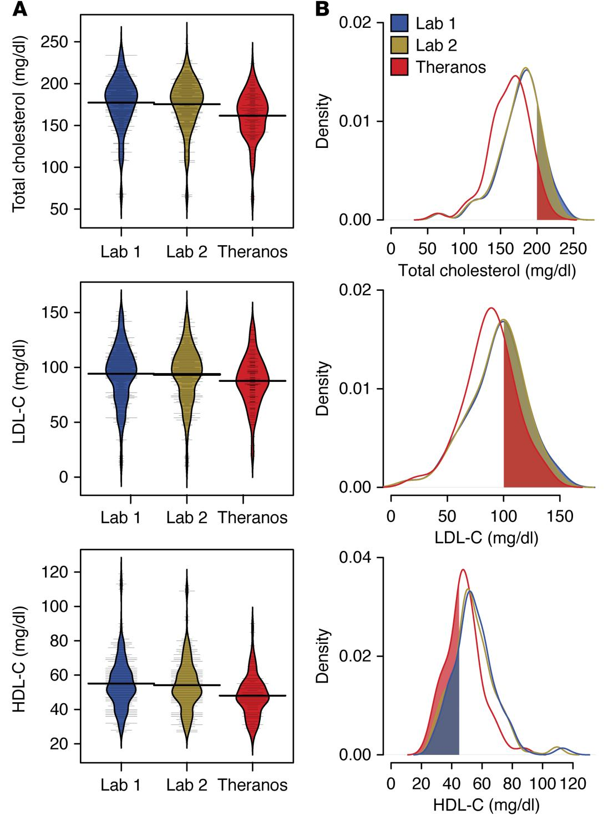
Thresholding in practice
Lab 3
Lab 3
Lab 3
Blood tests from 3 commercial testing sources
Cholesterol, LDL-C, HDL-C have defined normal ranges (upper and lower thresholds)
https://dm5migu4zj3pb.cloudfront.net/manuscripts/86000/86318/large/JCI86318.f4.jpg

Slide 11
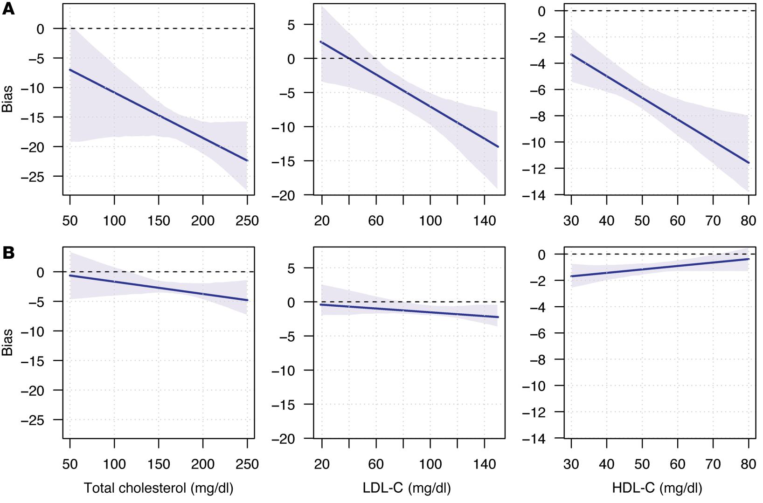
Assessing bias in measurements
I: Lab 3
J: Lab 1
I: Lab 2
J: Lab 1
Bias = discrepancy in using data source I as an estimator for data source J
https://dm5migu4zj3pb.cloudfront.net/manuscripts/86000/86318/large/JCI86318.f5.jpg

Slide 12



A tale of three labs
I: Lab 3
J: Lab 1
I: Lab 2
J: Lab 1
Lab 1
Lab 2
Lab 3
https://1000logos.net/wp-content/uploads/2021/03/Quest-Diagnostics-logo-768x502.png, https://hitconsultant.net/wp-content/uploads/2022/02/Ascension-Selects-Labcorp-to-Manage-Labs-Across-10-States.jpg, https://1000logos.net/wp-content/uploads/2020/11/Theranos-Logo-1024x640.png

Slide 13
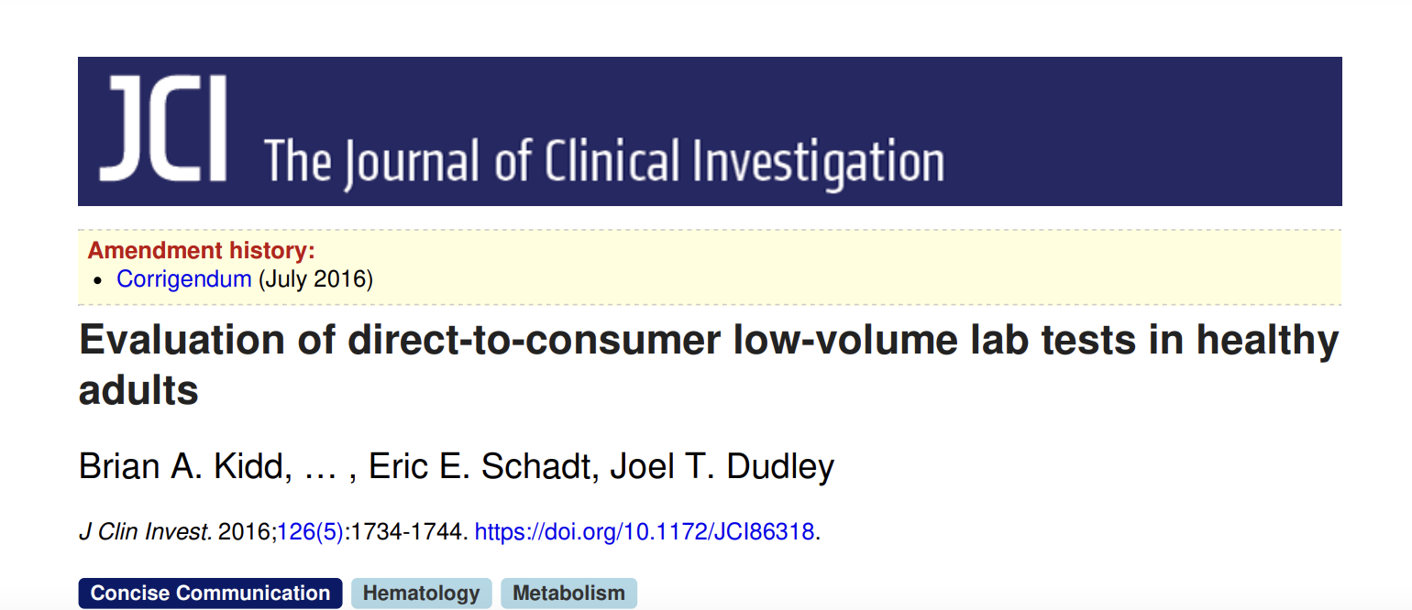
A tale of three labs
The lack of technical replicates in the Theranos data is a notable limitation in our assessment of variability. Given the large intraindividual variability for lab tests from standard clinical services, understanding the variability in low-volume testing is critical for helping physicians and patients interpret test results …
The technical details of the analytical instruments used for the lab tests were unavailable at the time of the study and remained uncertain since its completion, which means that the differences we found could arise from multiple sources…
https://www.jci.org/articles/view/86318/pdf

Slide 14
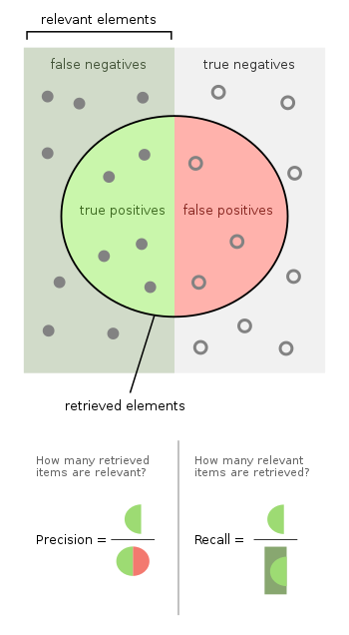
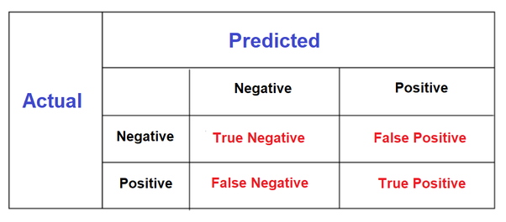
Classifying binary information
“Truth Table”
https://qph.cf2.quoracdn.net/main-qimg-d1f717f321a4ebc8e6d2c1d1cc19f9fc, https://upload.wikimedia.org/wikipedia/commons/thumb/2/26/Precisionrecall.svg/700px-Precisionrecall.svg.png

Slide 15
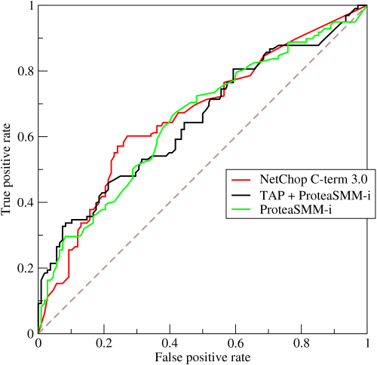
Receiver Operator Characteristic Curves
TPR = TP / (TP + FN)
FPR = FP / (FP + TN)
https://upload.wikimedia.org/wikipedia/commons/6/6b/Roccurves.png

Slide 16


Game time!
Two teams. Phones/computers away
Give each image a “cake score” of 1 (not likely to be cake) to 5 (super likely to be cake)
https://i.kym-cdn.com/entries/icons/original/000/001/707/thecakeisalie.jpg, https://dnm.nflximg.net/api/v6/2DuQlx0fM4wd1nzqm5BFBi6ILa8/AAAAQYwP3BYZ2Ri_-P-sY4_vtR9_fv6KPptWKKniY2_VxxOzqurvjAbe7bi4XPq2NbcH4vw99f1gFDyU_TZe7bkeHOBKNYccZkoFBoRsCHFtqWFtHPYk16RT26YMxUs8PffGpvROrvismA_Kt8PHRAuviZLp.jpg?r=b5e

Slide 17
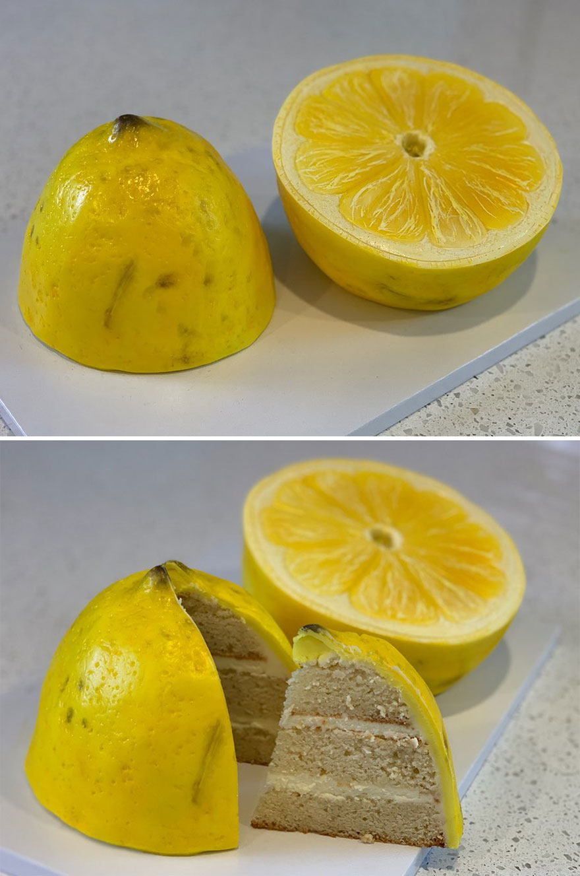
Is it cake? #1
https://static.boredpanda.com/blog/wp-content/uploads/2019/09/Artist-creates-hyper-realistic-cakes-inspired-by-objects-and-fruits-5d8869b5a64b7__880.jpg

Slide 18
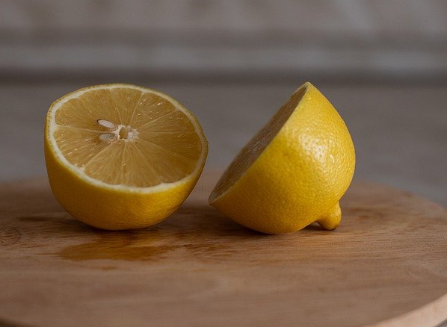
Is it cake? #2
https://cdn.pixabay.com/photo/2022/01/09/10/53/lemon-6925734_1280.jpg

Slide 19
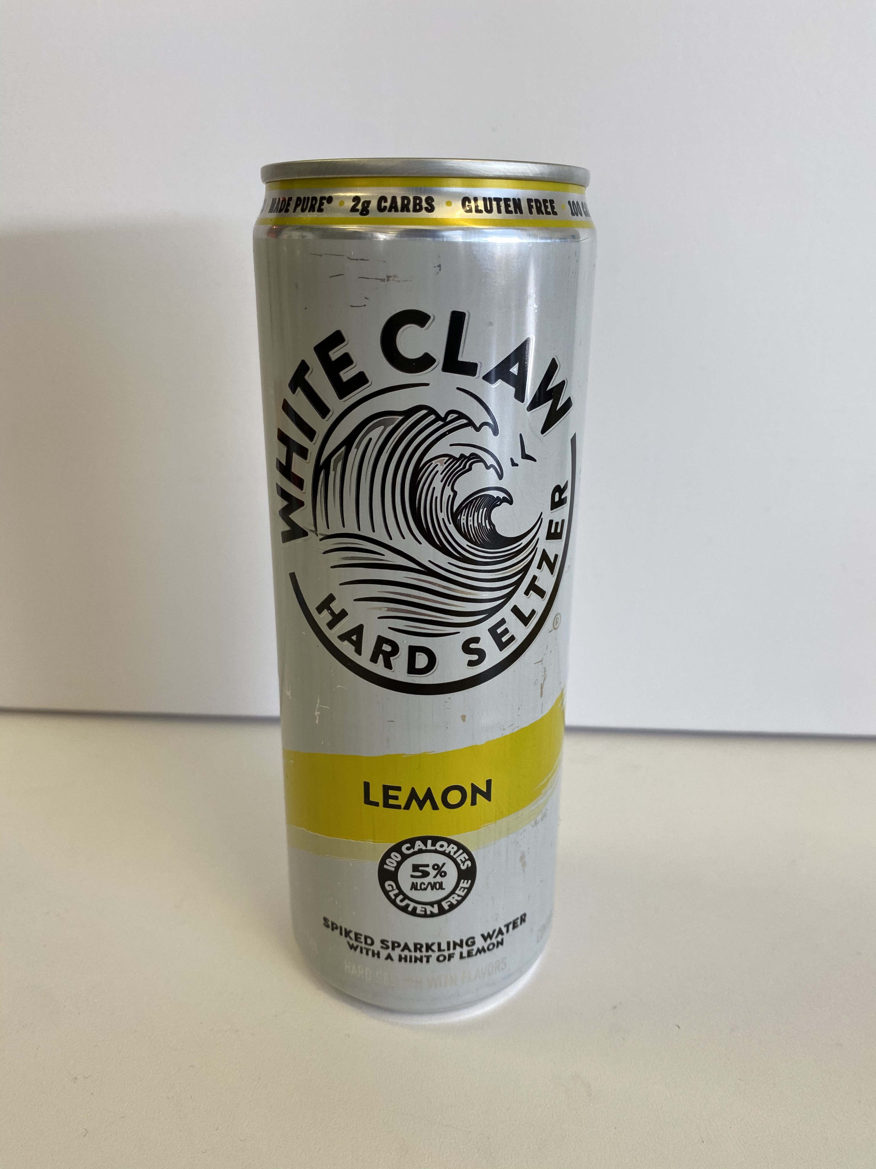
Is it cake? #3
https://cdn.apartmenttherapy.info/image/upload/v1582914079/k/Edit/IMG_1725.jpg

Slide 20
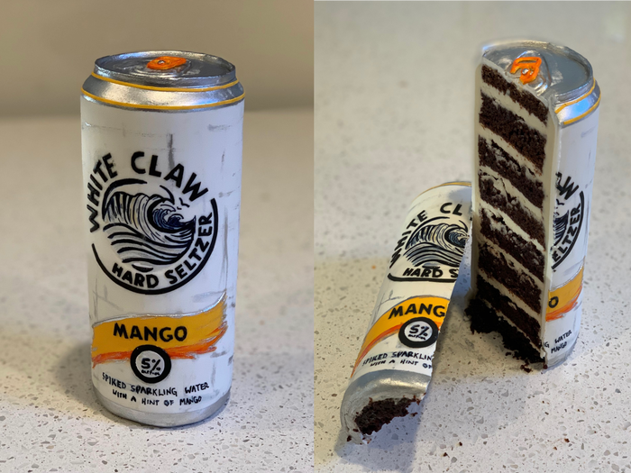
Is it cake? #4
https://i.insider.com/5d9c8d6c23f8645e02582215?width=1300&format=jpeg&auto=webp

Slide 21
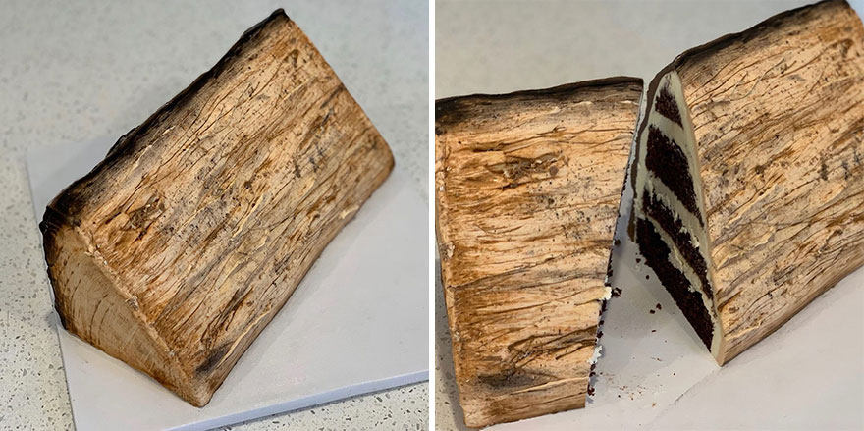
Is it cake? #5
https://static.boredpanda.com/blog/wp-content/uploads/2019/09/Artist-creates-hyper-realistic-cakes-inspired-by-objects-and-fruits-5d8869ba00e9f__880.jpg

Slide 22
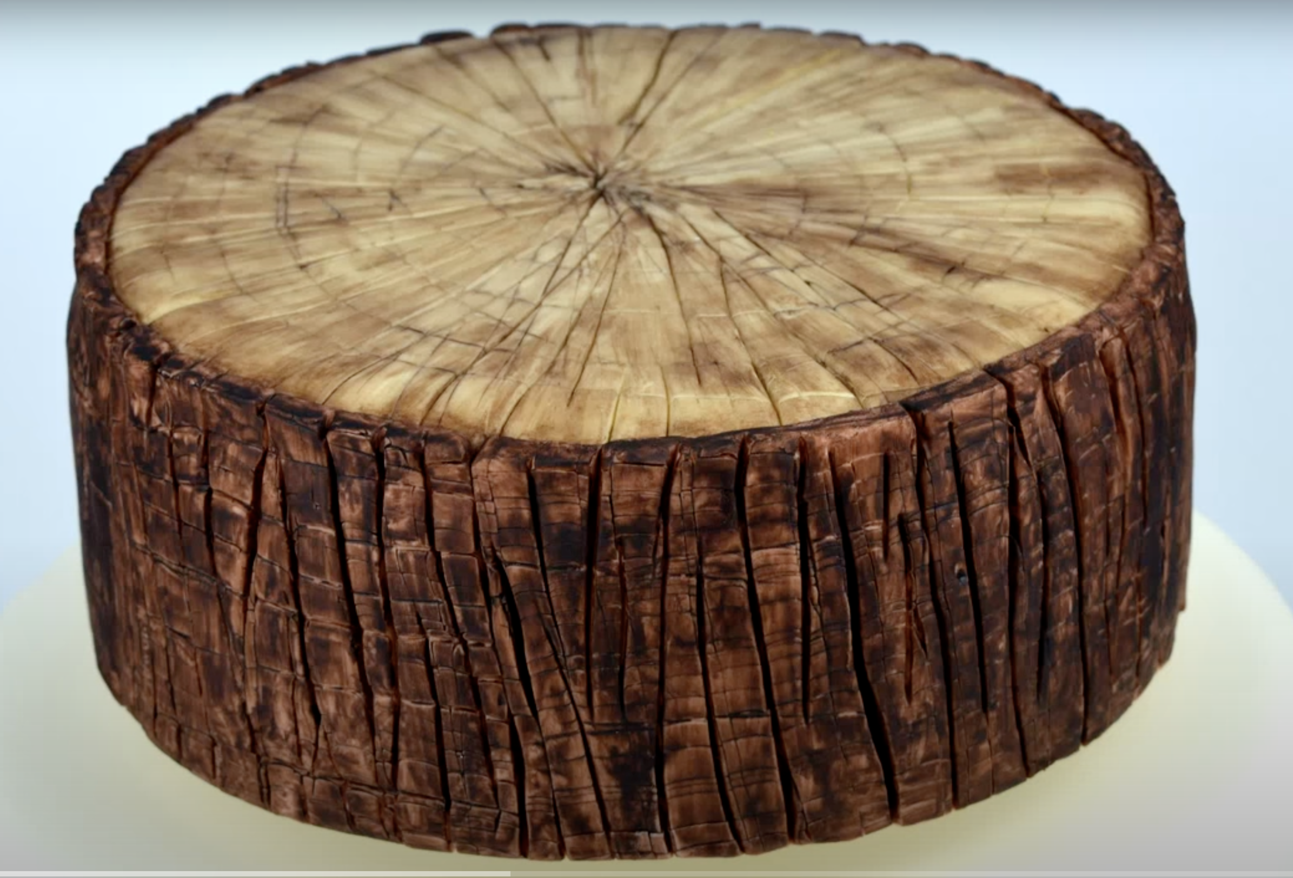
Is it cake? #6
https://www.youtube.com/watch?v=oZxCbuteM_4

Slide 23
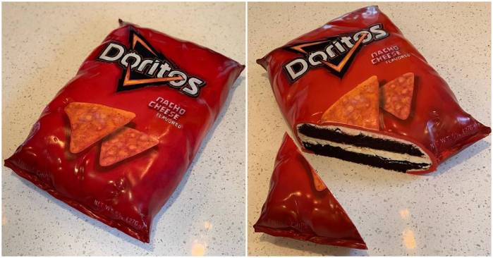
Is it cake? #7
https://i0.wp.com/awesomebyte.com/wp-content/uploads/2019/12/awesome-Cakes.jpg?w=1200&ssl=1

Slide 24
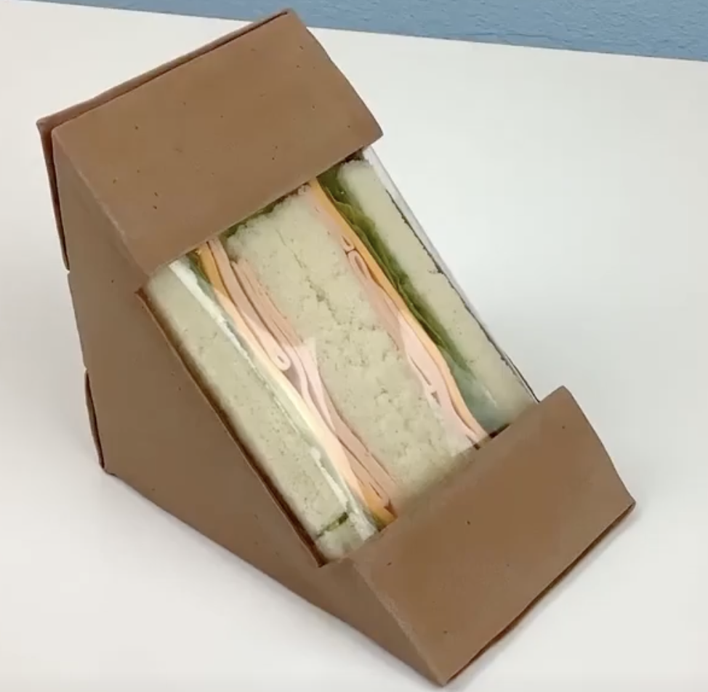
Is it cake? #8
https://www.unilad.co.uk/viral/womans-hyper-realistic-cakes-will-make-you-think-nothing-is-real

Slide 25
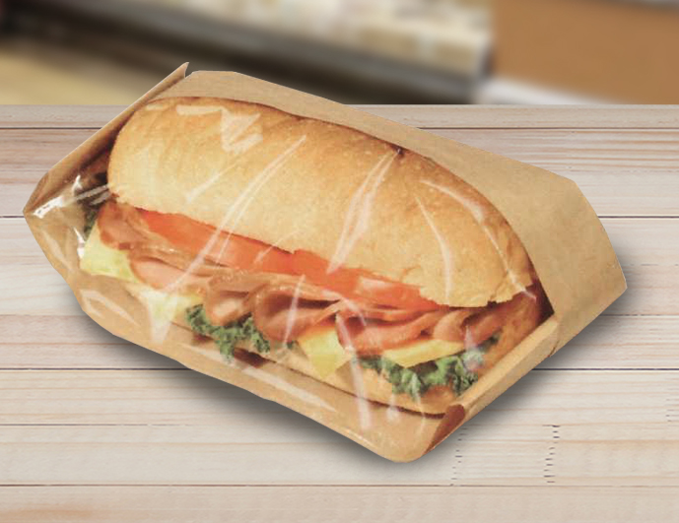
Is it cake? #9
https://www.google.com/url?sa=i&url=https%3A%2F%2Fwww.brenmarco.com%2Fproduct%2Fdubl-viewe-sandwich-bag-natural%2F&psig=AOvVaw2fYNNYMcieaqddoPlOZjLm&ust=1649908496451000&source=images&cd=vfe&ved=0CAoQjRxqFwoTCMjNxKCSkPcCFQAAAAAdAAAAABAR

Slide 26
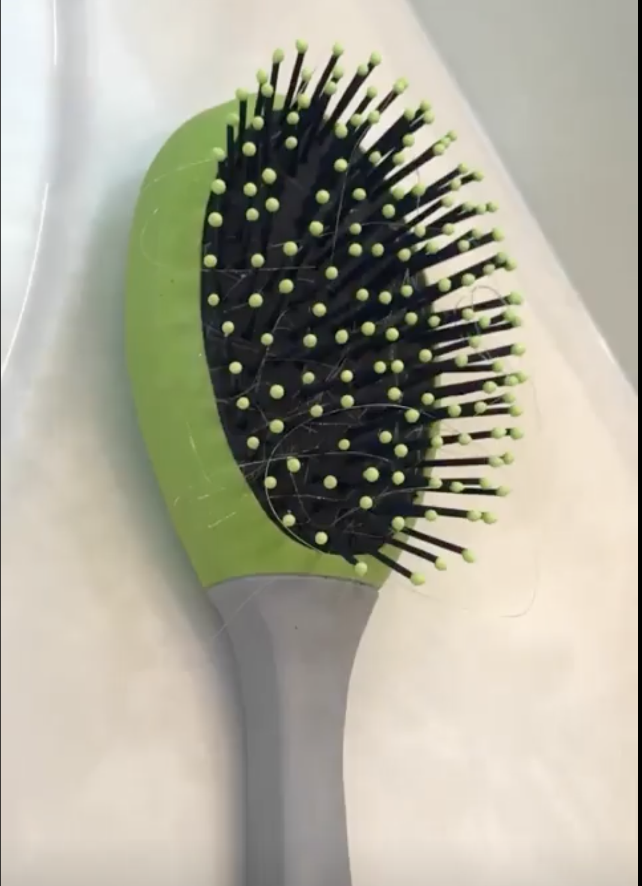
Is it cake? #10
https://www.unilad.co.uk/viral/womans-hyper-realistic-cakes-will-make-you-think-nothing-is-real

Slide 27
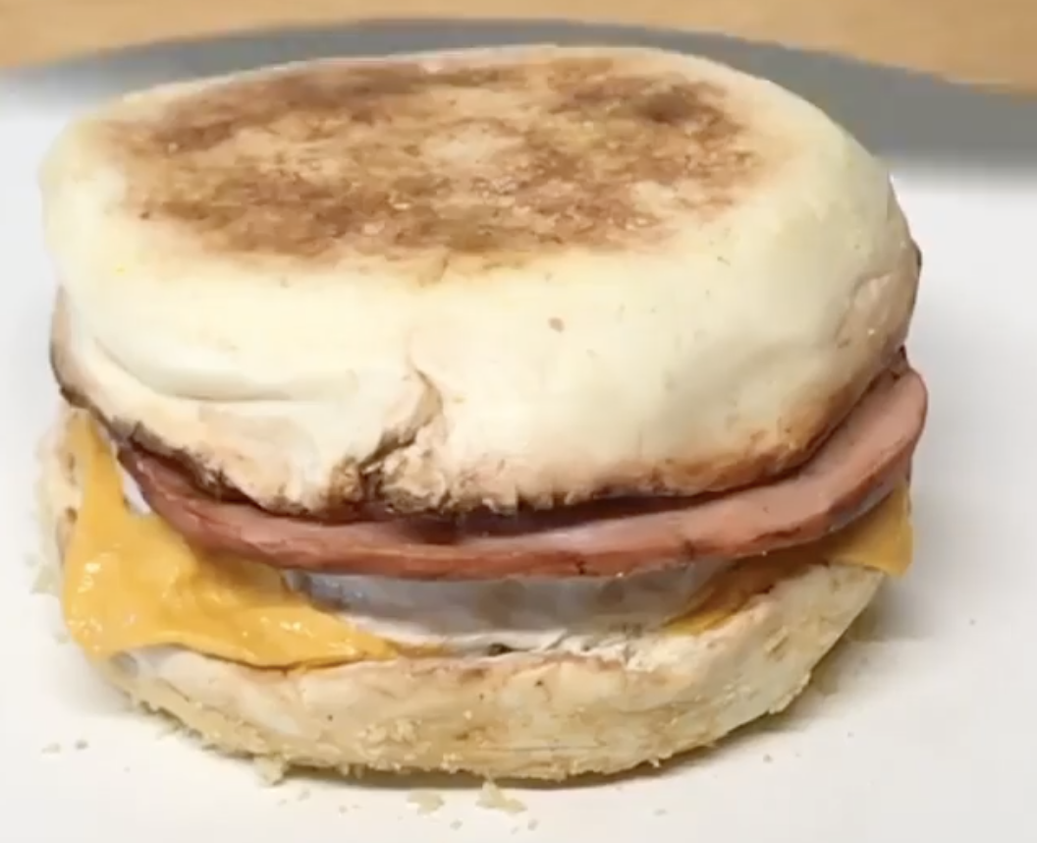
Is it cake? #11
https://www.unilad.co.uk/viral/womans-hyper-realistic-cakes-will-make-you-think-nothing-is-real

Slide 28
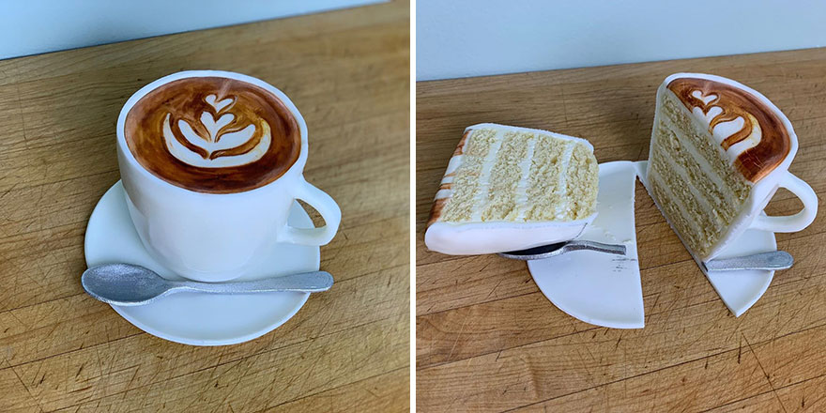
Is it cake? #12
https://static.boredpanda.com/blog/wp-content/uploads/2019/09/Artist-creates-hyper-realistic-cakes-inspired-by-objects-and-fruits-5d8869a2cf11c__880.jpg

Slide 29
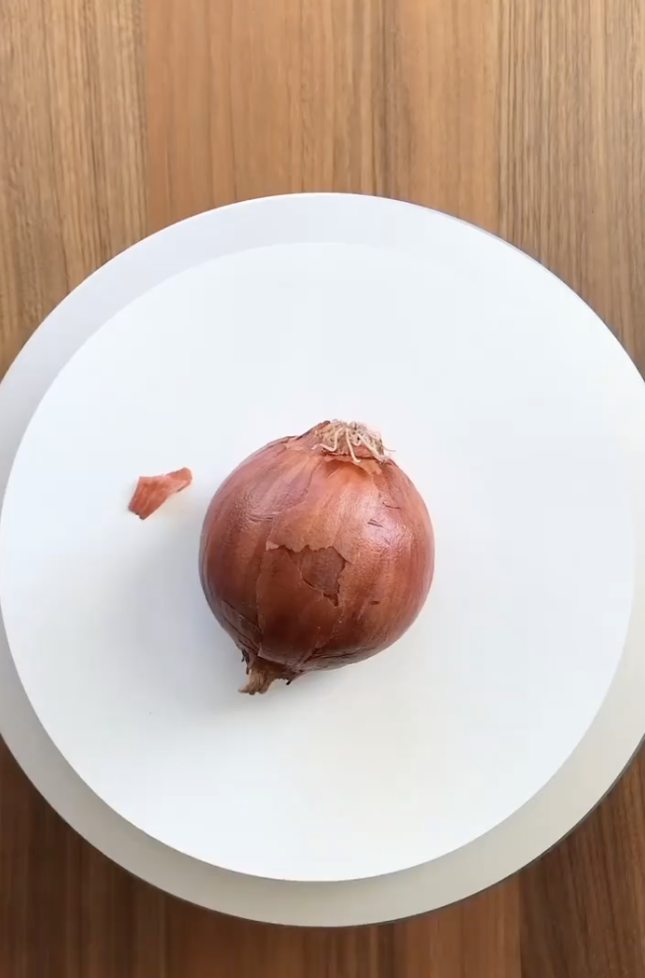
Is it cake? #13
https://www.instagram.com/p/CVN2X1TtwTA/?utm_source=ig_embed&utm_campaign=embed_video_watch_again

Slide 30
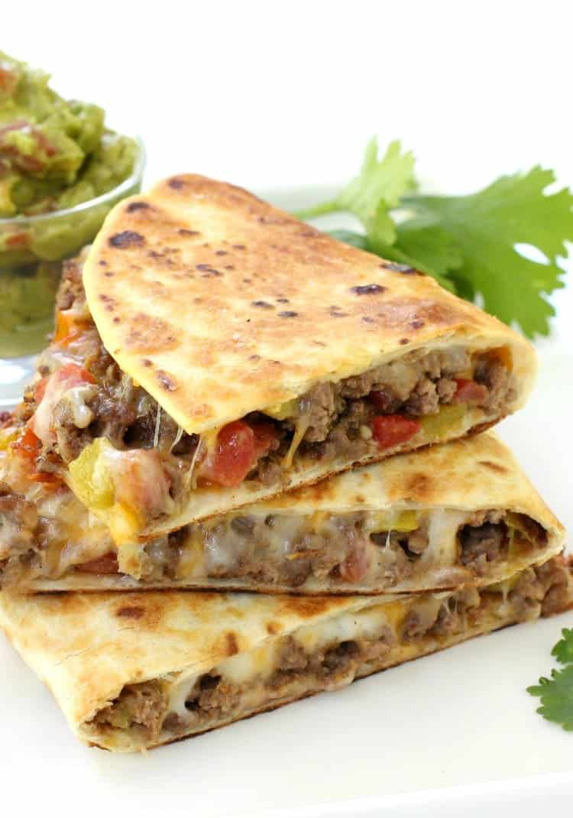
Is it cake? #14
https://www.mantitlement.com/wp-content/uploads/2016/07/pan-fried-beef-tacos-stacked-vert.jpg

Slide 31
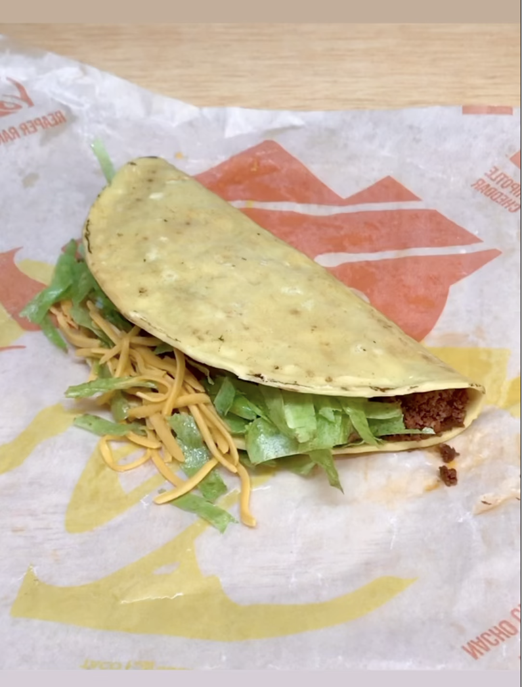
Is it cake? #15
https://www.instagram.com/p/Cb5EG01JfJC/

Slide 32
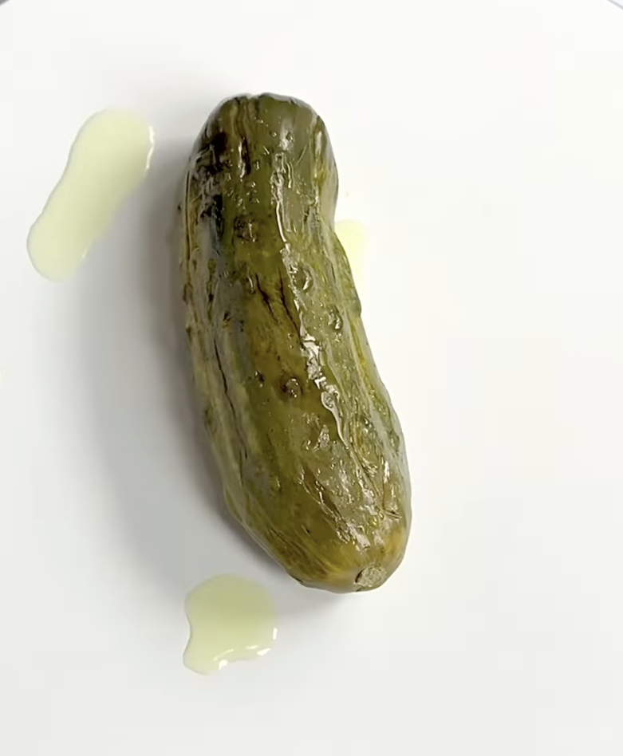
Is it cake? #16
https://www.instagram.com/p/CY4AFYVlhB7/

Slide 33
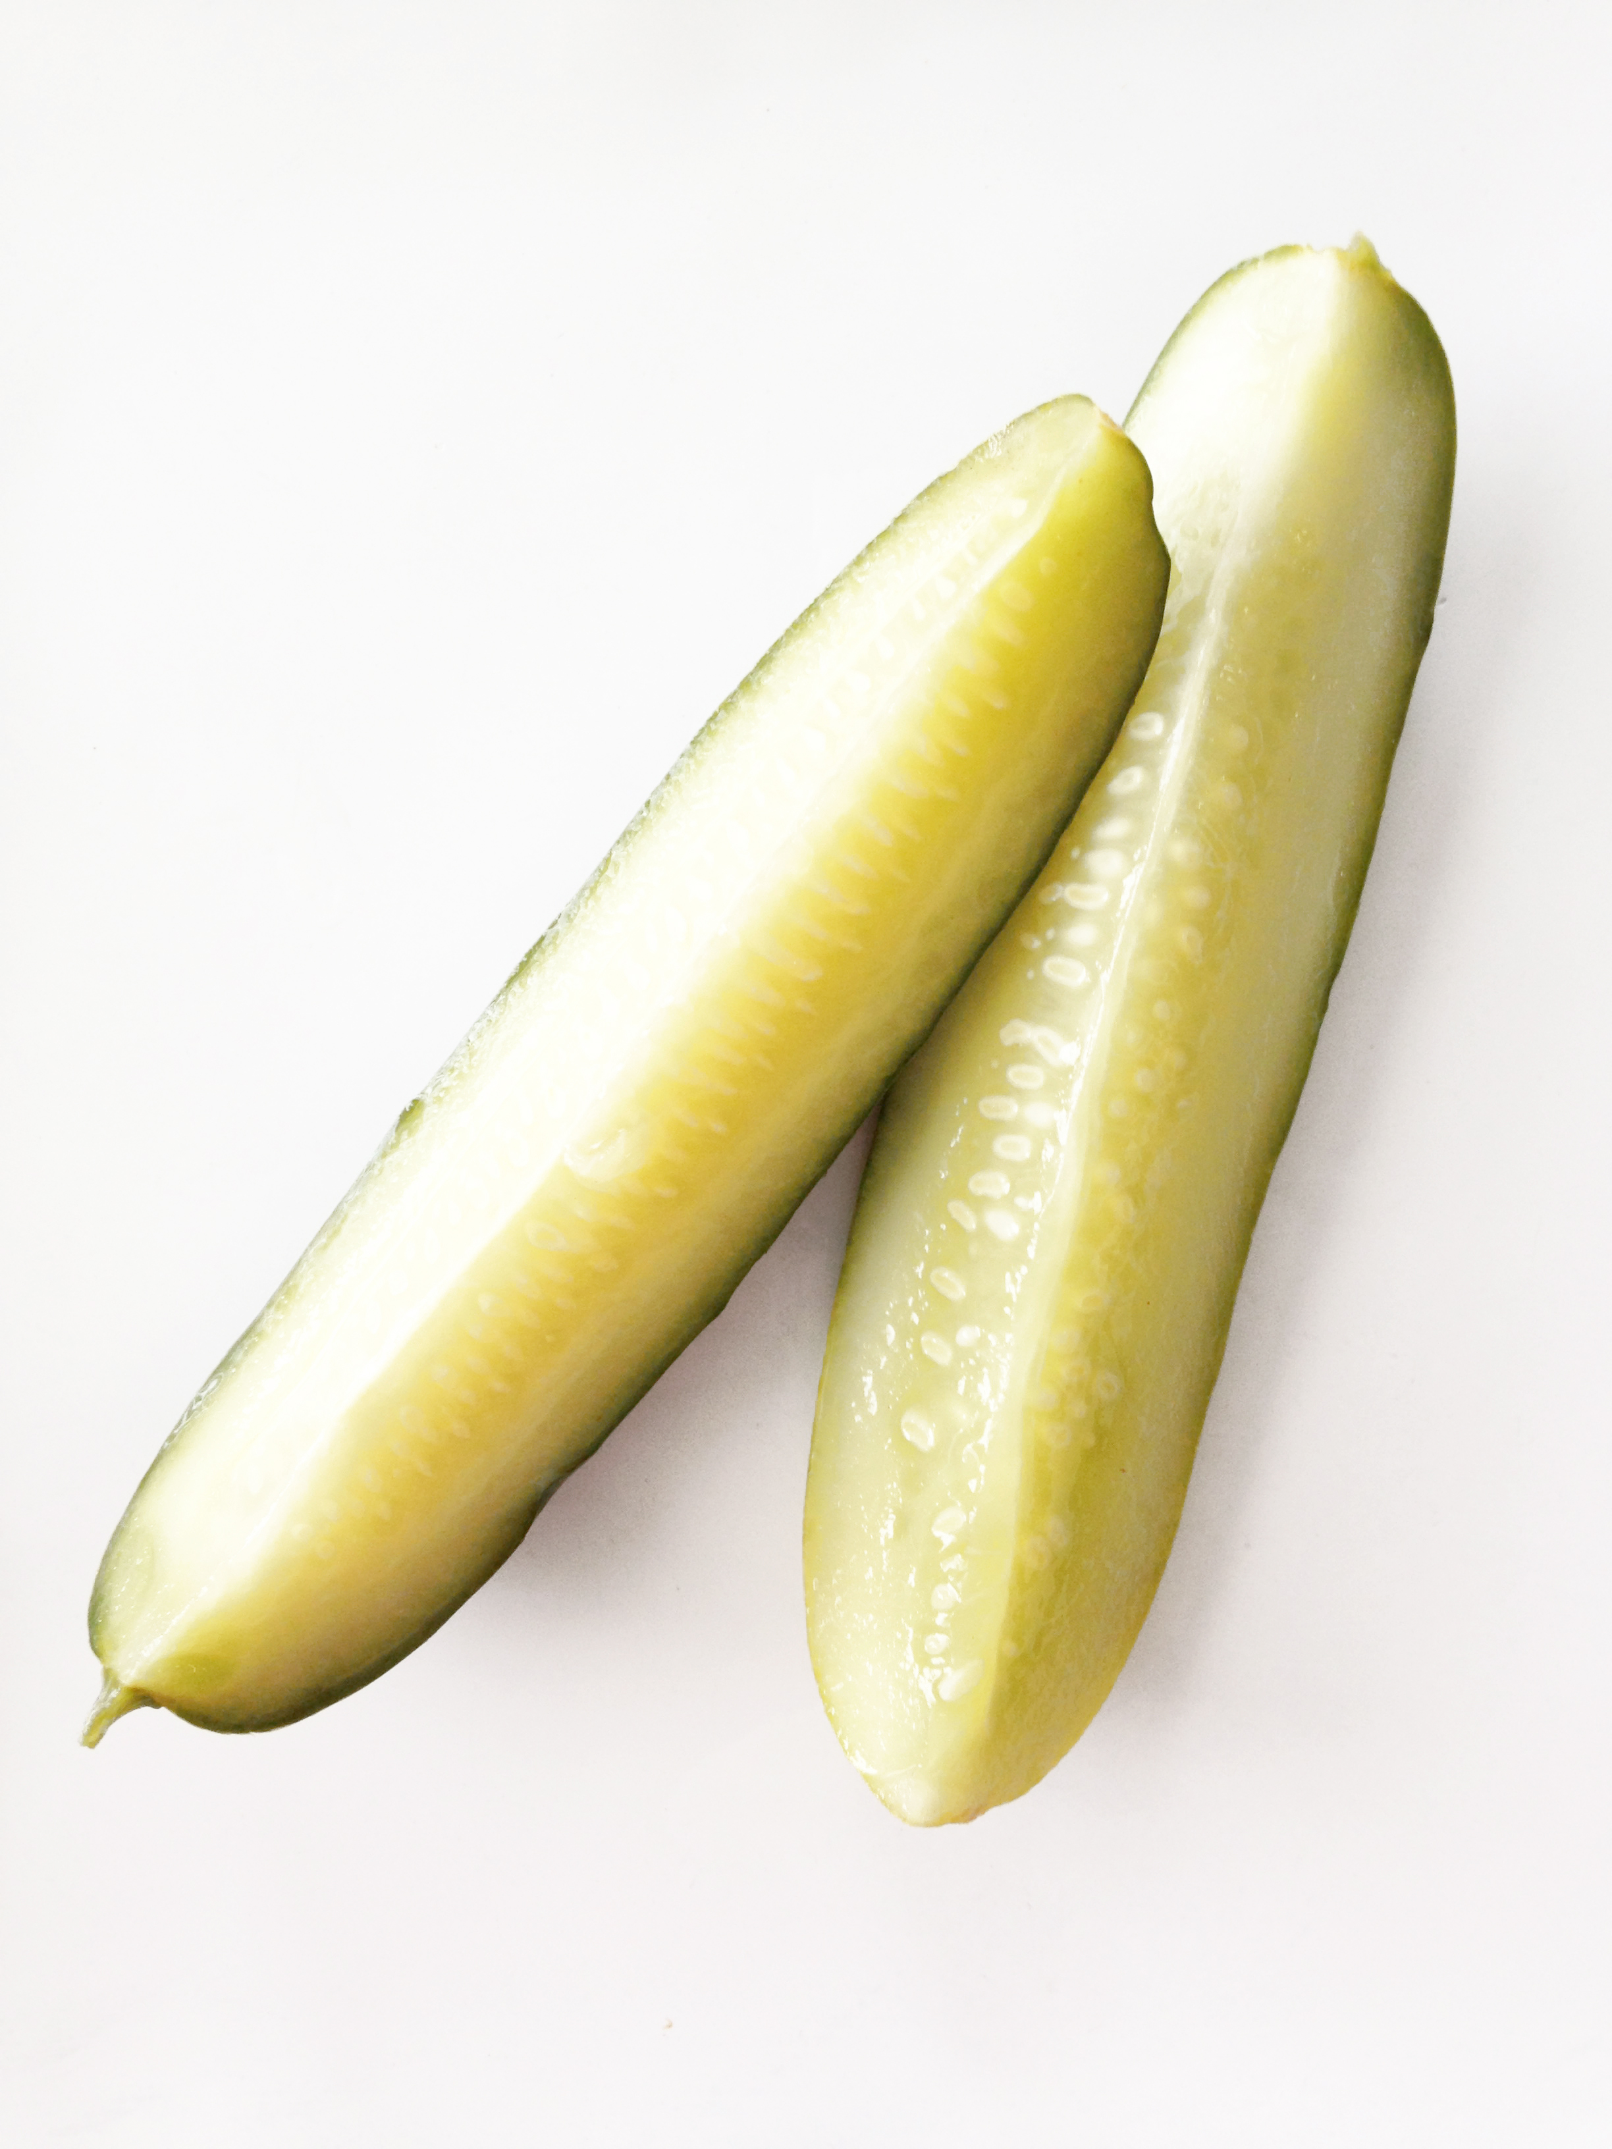
Is it cake? #17
https://images.squarespace-cdn.com/content/v1/5113fcede4b099bd04eebc8d/1409757529299-MONGSWKRNPCBSBMG5AAH/Photo+Sep+03%2C+9+47+49+AM.jpg

Slide 34
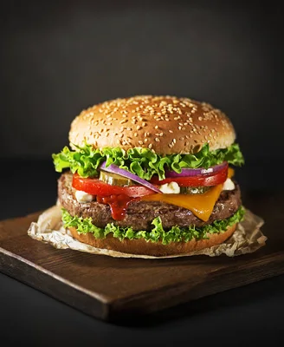
Is it cake? #18
https://st4.depositphotos.com/1009628/20306/i/600/depositphotos_203067720-stock-photo-homemade-hamburger-burger-fresh-vegetables.jpg

Slide 35
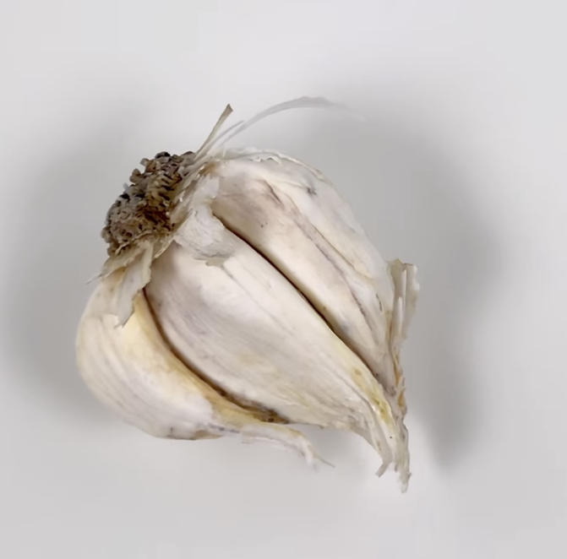
Is it cake? #19
https://www.instagram.com/p/Cb7nIAMl-RM/

Slide 36
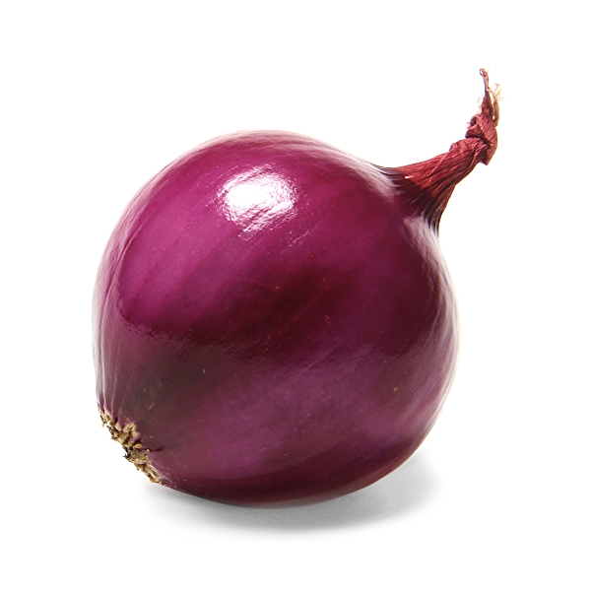
Is it cake? #20
https://m.media-amazon.com/images/S/assets.wholefoodsmarket.com/PIE/product/575f28f7c8ecc79afb742996_produce_redonions.1._TTD_._SR600,600_._QL100_.jpg

Slide 37
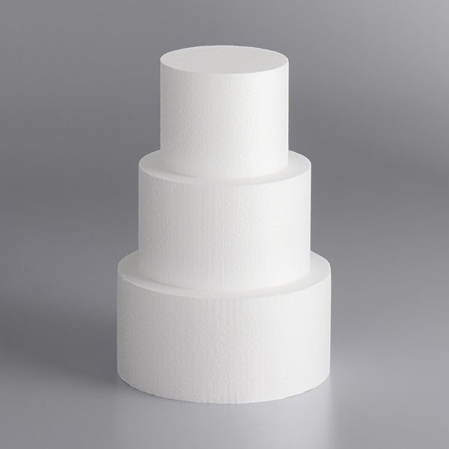
Is it cake? #21
https://cdnimg.webstaurantstore.com/images/products/large/527685/1949373.jpg

Slide 38
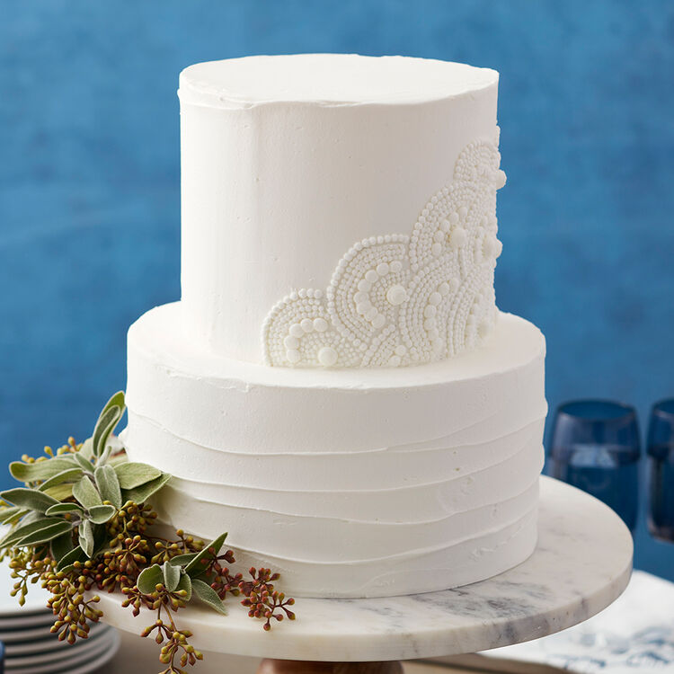
Is it cake? #22
https://www.wilton.com/dw/image/v2/AAWA_PRD/on/demandware.static/-/Sites-wilton-project-master/default/dw91adac21/images/project/WLPROJ-8535/Scalloped-White-Wedding-Cake.jpg?sw=1440&sh=750&sm=fit

Slide 40
#1: It’s cake!
https://static.boredpanda.com/blog/wp-content/uploads/2019/09/Artist-creates-hyper-realistic-cakes-inspired-by-objects-and-fruits-5d8869b5a64b7__880.jpg

Slide 41
#2: Not cake!
https://cdn.pixabay.com/photo/2022/01/09/10/53/lemon-6925734_1280.jpg

Slide 42
#3: Not cake!
https://cdn.apartmenttherapy.info/image/upload/v1582914079/k/Edit/IMG_1725.jpg

Slide 43
#4: It’s cake!
https://i.insider.com/5d9c8d6c23f8645e02582215?width=1300&format=jpeg&auto=webp

Slide 44
#5: It’s cake!
https://static.boredpanda.com/blog/wp-content/uploads/2019/09/Artist-creates-hyper-realistic-cakes-inspired-by-objects-and-fruits-5d8869ba00e9f__880.jpg

Slide 45
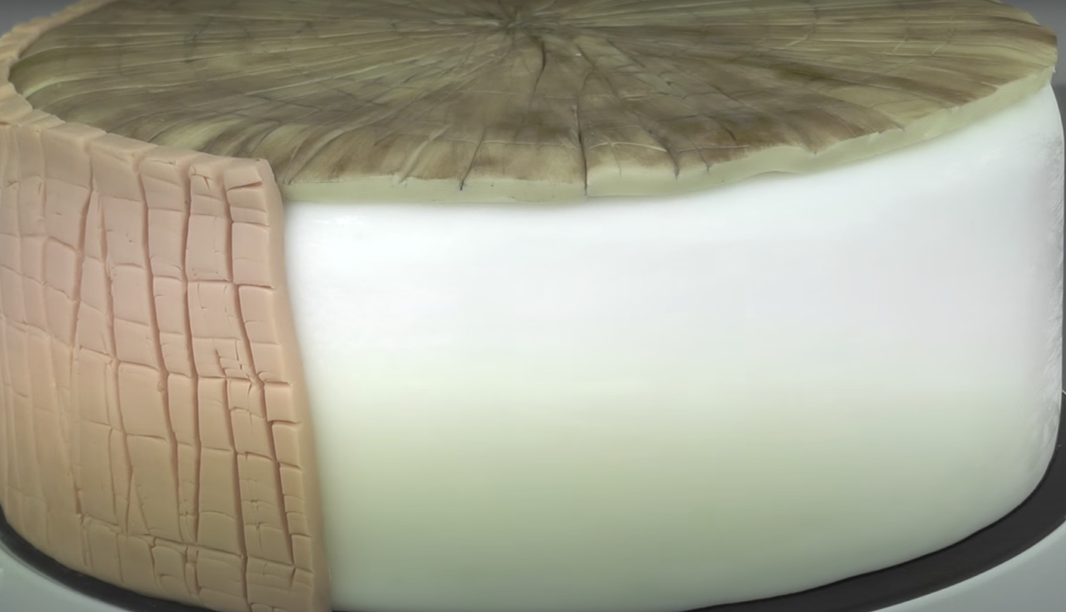
#6: It’s cake!
https://www.youtube.com/watch?v=oZxCbuteM_4

Slide 46
#7: It’s cake!
https://i0.wp.com/awesomebyte.com/wp-content/uploads/2019/12/awesome-Cakes.jpg?w=1200&ssl=1

Slide 47
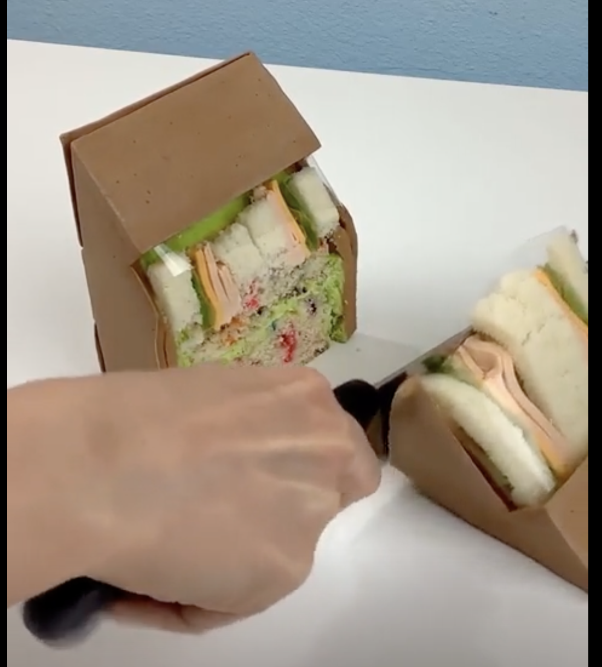
#8: It’s cake!
https://www.unilad.co.uk/viral/womans-hyper-realistic-cakes-will-make-you-think-nothing-is-real

Slide 48
#9: Not cake!
https://www.google.com/url?sa=i&url=https%3A%2F%2Fwww.brenmarco.com%2Fproduct%2Fdubl-viewe-sandwich-bag-natural%2F&psig=AOvVaw2fYNNYMcieaqddoPlOZjLm&ust=1649908496451000&source=images&cd=vfe&ved=0CAoQjRxqFwoTCMjNxKCSkPcCFQAAAAAdAAAAABAR

Slide 49
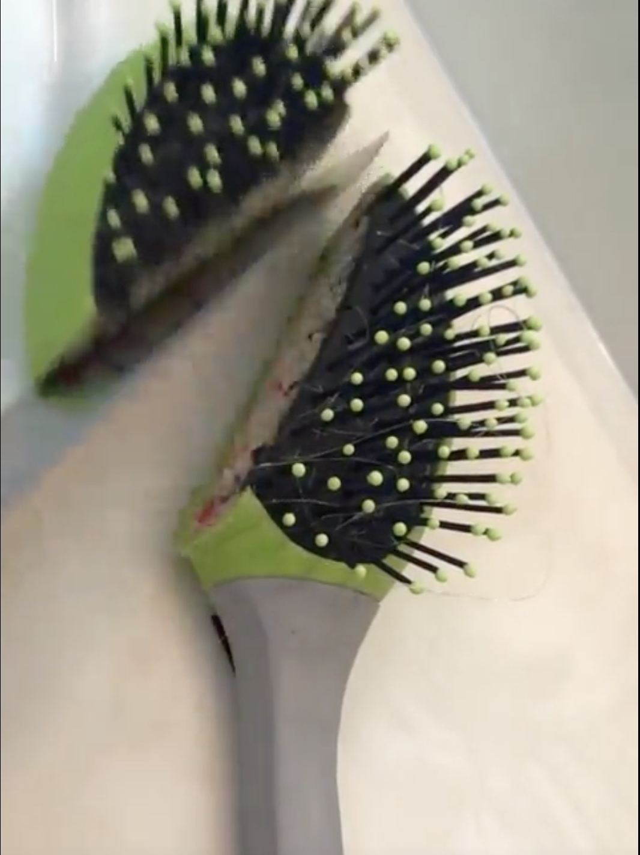
#10: It’s cake!
https://www.unilad.co.uk/viral/womans-hyper-realistic-cakes-will-make-you-think-nothing-is-real

Slide 50
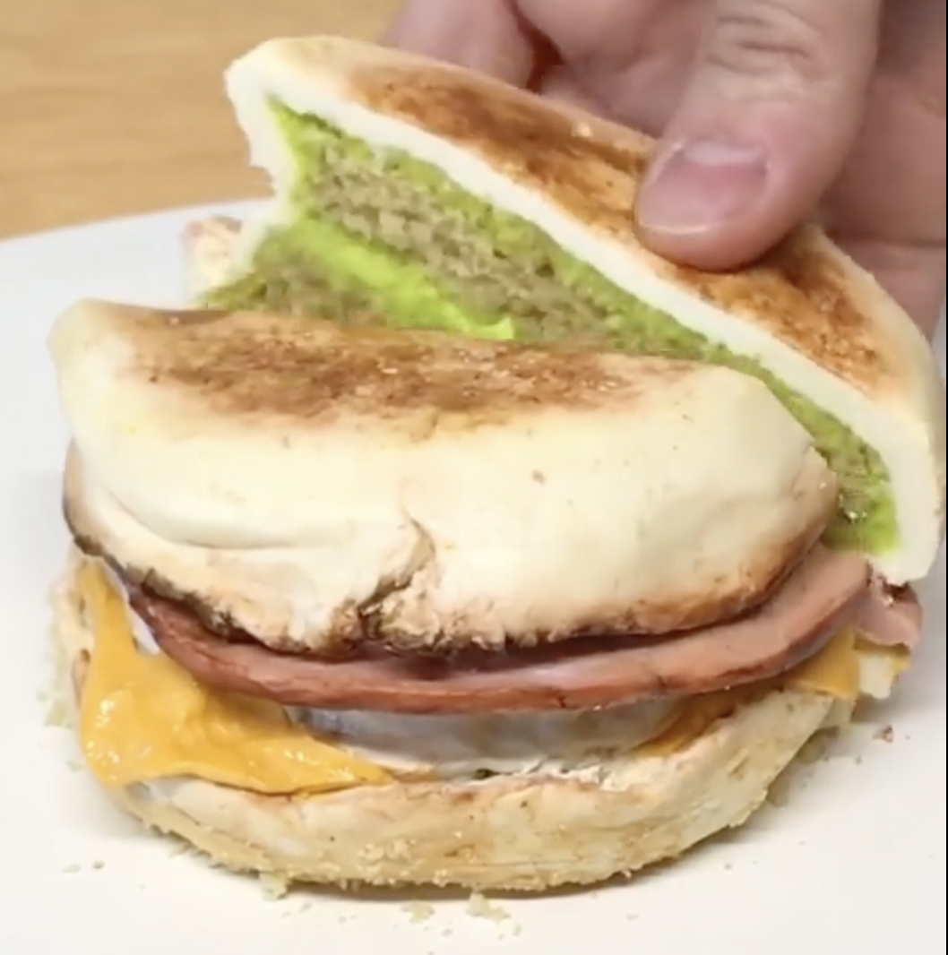
#11: It’s cake!
https://www.unilad.co.uk/viral/womans-hyper-realistic-cakes-will-make-you-think-nothing-is-real

Slide 51
#12: It’s cake!
https://static.boredpanda.com/blog/wp-content/uploads/2019/09/Artist-creates-hyper-realistic-cakes-inspired-by-objects-and-fruits-5d8869a2cf11c__880.jpg

Slide 52
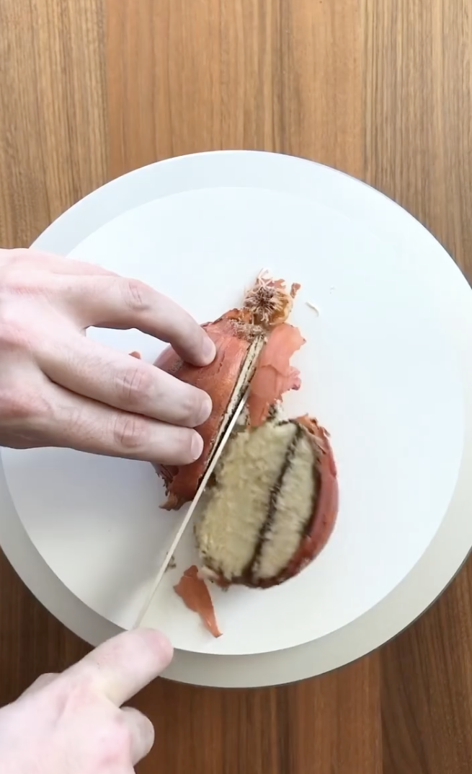
#13: It’s cake!
https://www.instagram.com/p/CVN2X1TtwTA/?utm_source=ig_embed&utm_campaign=embed_video_watch_again

Slide 53
#14: Not cake!
https://www.mantitlement.com/wp-content/uploads/2016/07/pan-fried-beef-tacos-stacked-vert.jpg

Slide 54
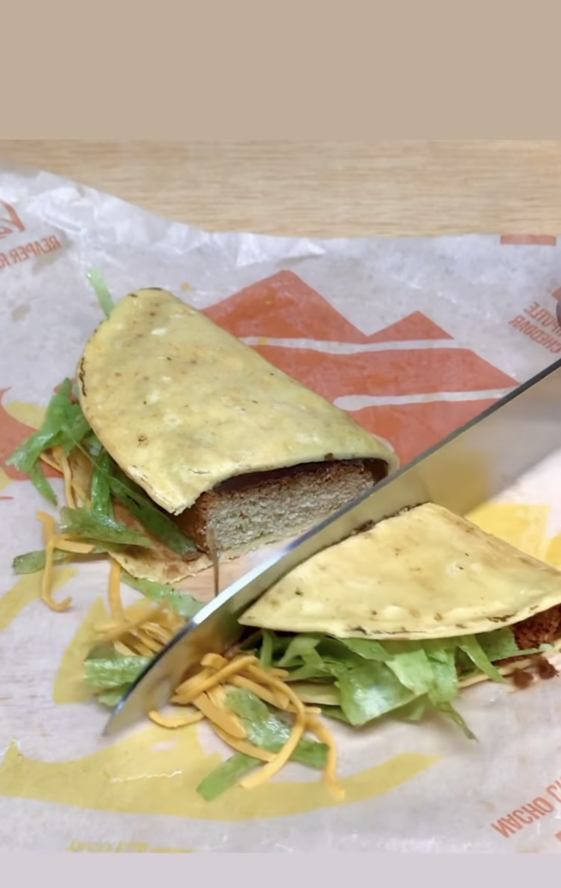
#15: It’s cake!
https://www.instagram.com/p/Cb5EG01JfJC/

Slide 55
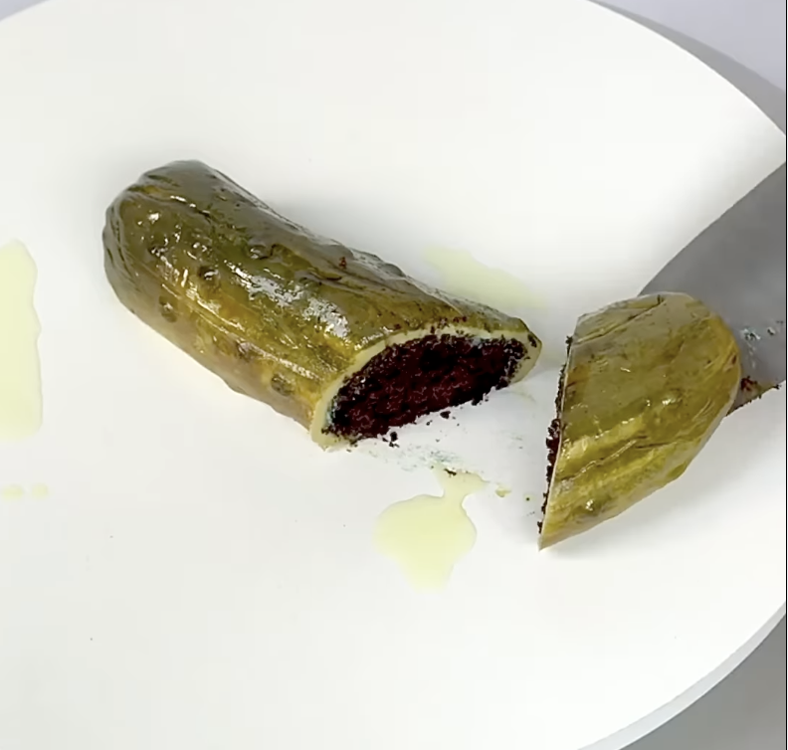
#16: It’s cake!
https://www.instagram.com/p/CY4AFYVlhB7/

Slide 56
#17: Not cake!
https://images.squarespace-cdn.com/content/v1/5113fcede4b099bd04eebc8d/1409757529299-MONGSWKRNPCBSBMG5AAH/Photo+Sep+03%2C+9+47+49+AM.jpg

Slide 57
#18: Not cake!
https://st4.depositphotos.com/1009628/20306/i/600/depositphotos_203067720-stock-photo-homemade-hamburger-burger-fresh-vegetables.jpg

Slide 58
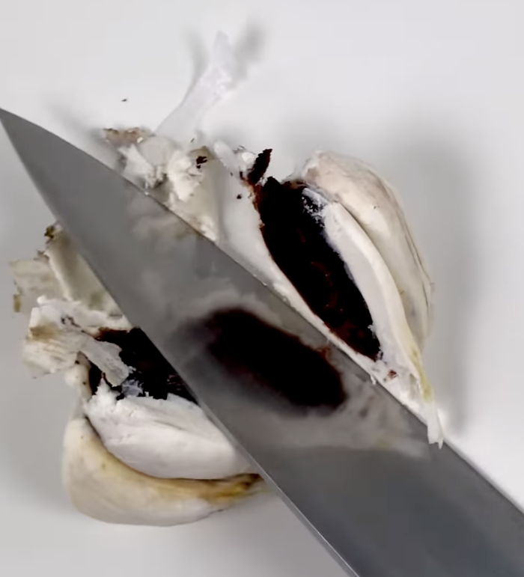
#19: It’s cake!
https://www.instagram.com/p/Cb7nIAMl-RM/

Slide 59
#20: Not cake!
https://m.media-amazon.com/images/S/assets.wholefoodsmarket.com/PIE/product/575f28f7c8ecc79afb742996_produce_redonions.1._TTD_._SR600,600_._QL100_.jpg

Slide 60
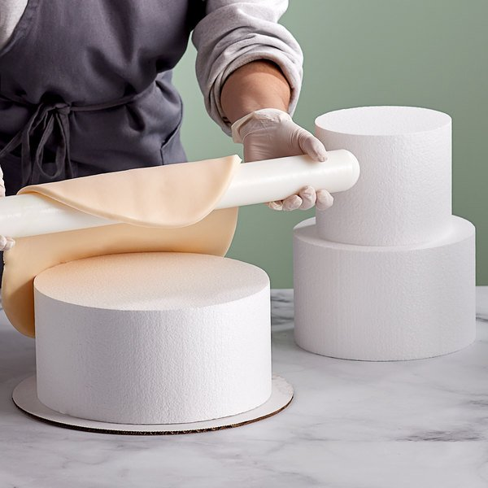
#21: Not cake!
https://cdnimg.webstaurantstore.com/images/products/large/527685/1949374.jpg

Slide 61
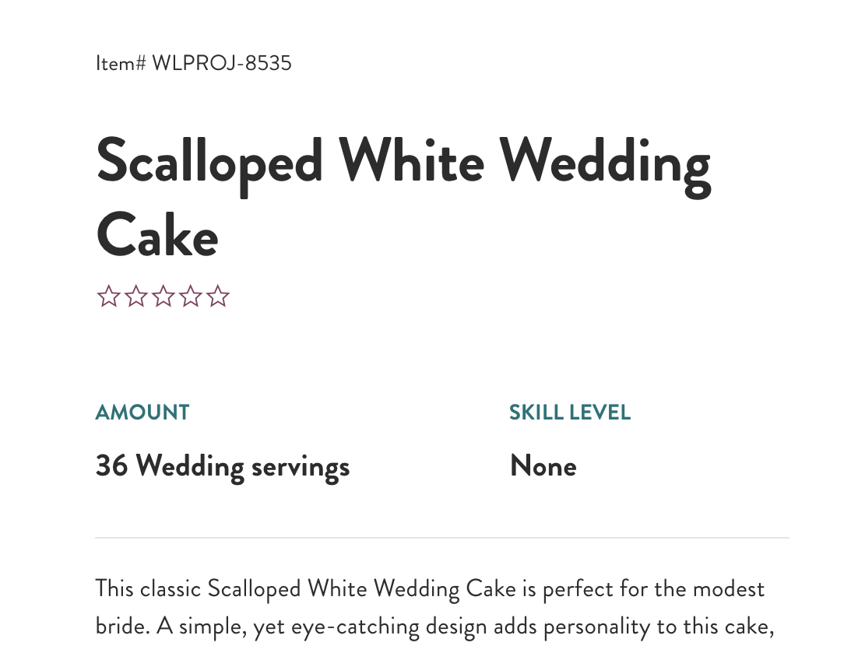
#22: It’s cake!
https://www.wilton.com/dw/image/v2/AAWA_PRD/on/demandware.static/-/Sites-wilton-project-master/default/dw91adac21/images/project/WLPROJ-8535/Scalloped-White-Wedding-Cake.jpg?sw=1440&sh=750&sm=fit

Slide 62
Exercise: ROC out your cake results
Generate your (FPR, TPR) for cake scores 1–5
Plot a curve and measure (or estimate) AUC
TPR = TP / (TP + FN)
FPR = FP / (FP + TN)
https://upload.wikimedia.org/wikipedia/commons/6/6b/Roccurves.png

